Slide 1
Software Lab Alpha/Beta Presentation
Alex Richardson & Joshua Patterson
11/20/2019

Slide 2
Project Overview/ Justification
World’s very first AI music producer using Generative Adversarial Networks (GAN)
Online marketplace to buy AI generated beats
Will output a newly generated beat on click by processing random noise through our generator network
Implementing our music production backgrounds.
Solving an issue within the music industry by utilizing our knowledge of programming and music production.
yung gan

Slide 3
Deep Networks
Trains weights in network
Network made up of many layers
Needs lots of data and annotations

Slide 4
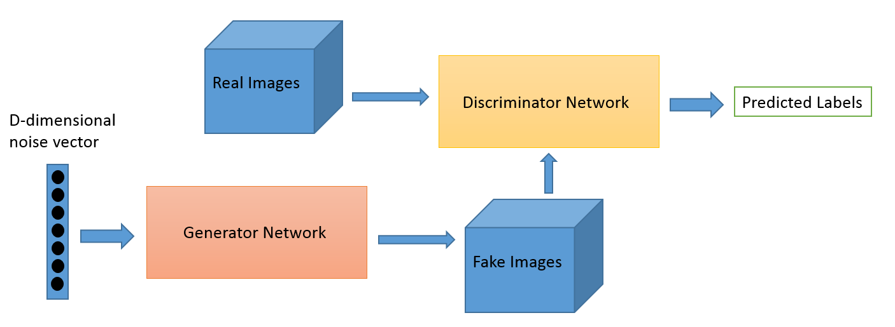
Generative Adversarial Networks (GAN)
Two deep networks
Generator
Discriminator
Networks train each other adversarially
Can only produce authentic results of size 128x128 pixels

Slide 5
Convolutional Neural Networks (CNN)
Moving kernels initialized with random weights
Filters correspond to the number of randomly initialized kernels
Useful in upsizing and downsizing
Nodes are locally connected

Slide 6
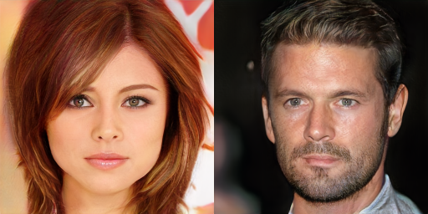
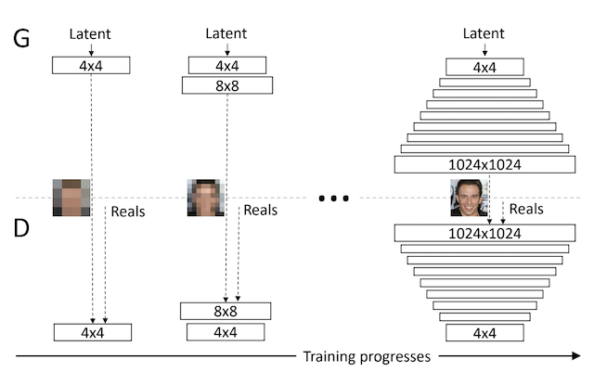
Progressive Growing GAN (PGGAN)
Can output authentic results of size 1024x1024 pixels!
Input data begins as low quality
Data increases in quality as more layers are added during the training process

Slide 7
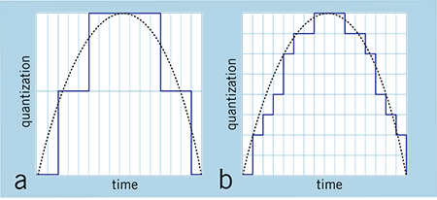
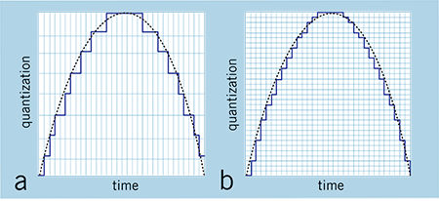
Digital Audio
Bit Depth:
The precision of each data point
Standard is 16 bit audio
Sample Rate:
The number of samples taken per second
Standard is 44,100 kHz audio

Slide 8
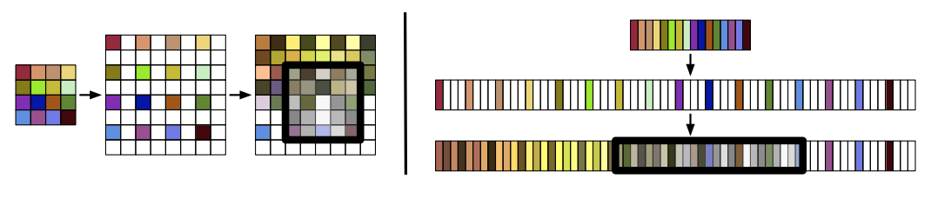
WaveGAN
Works with raw audio!
Long kernels
Size 16384 sounds instead of 128x128 images
Only works on 1 second of audio!
Trained on piano, drums, human voice, and bird noises

Slide 9
yung gan
Operation | Output Shape
Random Noise | (100,)
Dense | (5512,),
Inverse Convolution Kernel Size: 25 Stride: 4 | (11025,)
Batch Normalization ReLU Activation | (11025,)
Inverse Convolution Kernel Size: 25 Stride: 4 | (22050,)
Batch Normalization ReLU Activation | (22050,)
Inverse Convolution Kernel Size: 25 Stride: 4 | (44100,)
Tanh Activation | (44100,)
Combo of WaveGAN and PGGAN to achieve short slices of high quality audio
Uses sliced Soundcloud songs at a consistent tempo
 | WaveGAN | yung gan
Input Size: | 16384 | 44100

Slide 10
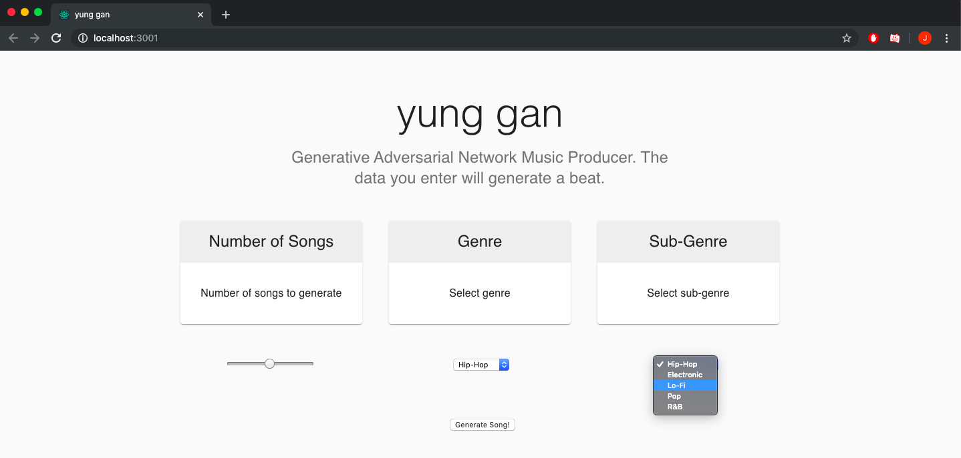
UI

Slide 11
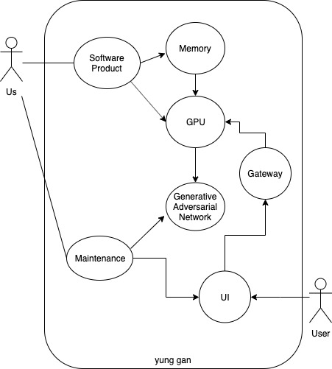
Use Case Diagram

Slide 12
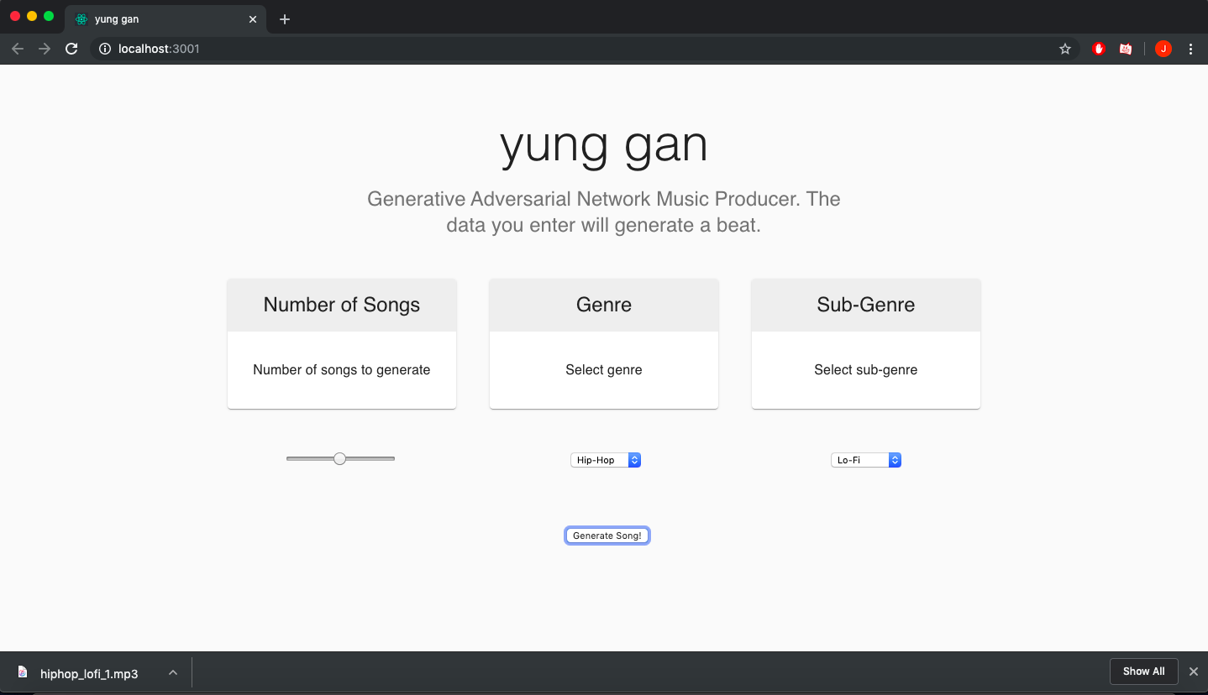
Front-end
Created using React JS
Fetches the GAN’s parameters
3 Parameters
Number of Songs
Genre
Sub-Genre
- Downloads mp3 file
generator.py <num songs> <output filepath> -g <genre> -sg <sub-genre> -fp <generator filepath> generator.py 1 path/to/output -g hip-hop -sg lo-fi
Other possible parameters

Slide 13
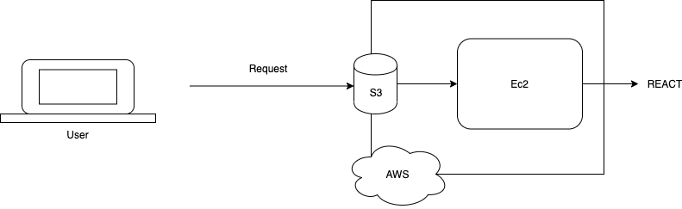
Using AWS
In order to create a bridge between our python program and a front-end, the program must be invoked via a URL.
We need to read/write mp3 files, therefore AWS Lambda wouldn’t be a good fit (Modern Solution).
We hosted the python program on a GPU Powered EC2 Virtual Machine.
Has an IP address, where the React code would just make fetch calls to it with specific URLs.
Notes:
Aws lambda is a serverless computing service that allows us to run our code without management, however, it cannot read or write files.

Slide 14
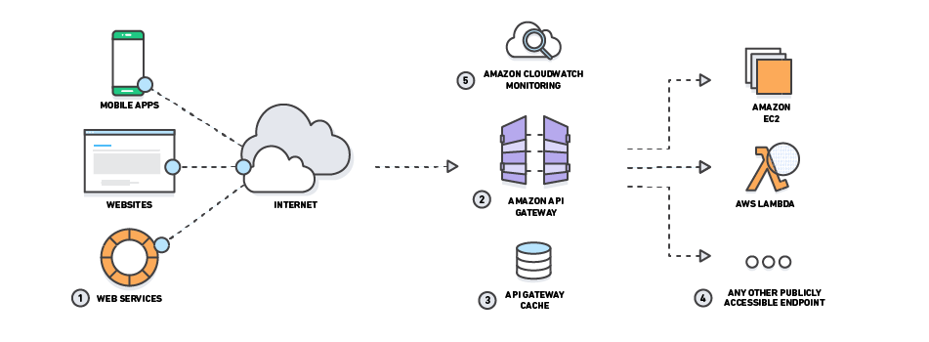
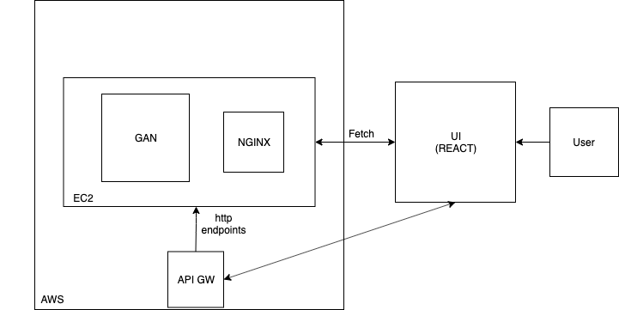
API Gateway
How do we determine these URLs?
-By having Amazon APIGW point to http endpoints on our EC2, our React code can send fetch calls to the EC2 our program is stored in.
-We also need nginx within the EC2, that converts URLs into executed code on the EC2 server.
Notes:
NGINX is an HTTP server that converts those URLs into executed commands or code on the EC2 server.
stores and delivers the content for a website – such as text, images, video, and application data – to clients that request it.

Slide 15
Status Update
Accomplishments Created a GAN that could potentially train and generate models. Was able to start training for the neural network through AWS. Planned a UI to connect to the program. | Issues Memory/GPU Size Finding the proper components to fetch calls to the EC2. Producing high quality audio Producing long segments
Plan Forward Successfully link the GAN to our UI using Amazon Web Service Components. Implement a Database. Design combo model with PGGAN and WaveGAN. Plan a marketing service for our UI (subscription). | Costs AWS Services - GPU - Memory - Hosting - More Training Models

Slide 16
Thank You
Questions?

